Slide 1

Emertxe Information Technologies
IOT Internship Project Presentation
Project Title : IOT based Home Automation System
Presented by : Yashashri Gawande

Slide 2
Table of Contents
Arduino
Introduction to IOT
Embedded System
Home Automation
Blynk Platform
PICSimLab Simulator
Mapping
Block Diagram
Simulation
Conclusion

Slide 3
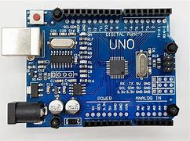
Arduino
Arduino is a project, open-source hardware, and software platform used to design and build electronic devices. It designs and manufactures microcontroller kits and single-board interfaces for building electronics projects.
Arduino boards are able to read inputs - light on a sensor, a finger on a button, or a Twitter message and turn it into an output activating a motor, turning on an LED.
The features of Arduino are listed below:
Arduino programming is a simplified version of C++, which makes the learning process easy.
Arduino does not need an extra board or piece to load new code.
Arduino can read analog and digital input signals.
The hardware and software platform is easy to use and implement.

Slide 4
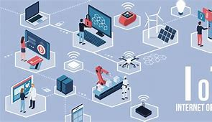
Internet of Things (IOT)
Internet of Things is the concept of connecting any device to the Internet and to other connected devices.
Devices and objects with built in sensors are connected to an Internet of Things platfom, which integrates data from the different devices and applies analytics to share the most valuable information with applications built to address specific needs and about the environment around them.
IoT is used in the following areas:
Product flow monitoring
Factory digitization
Inventory management
Safety and security
Logistics and Supply Chain Optimization
Quality control

Slide 5
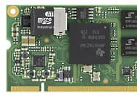
Embedded Systems
An Embedded System is a system that has software embedded into computer-hardware, which makes a system dedicated for a variety of application or specific part of an application or product or part of a larger system.
Characteristics of an Embedded System
Single-functioned
Tightly constrained
Reactive and Real time
Microprocessors based
Memory
Connected .
HW-SW systems

Slide 6
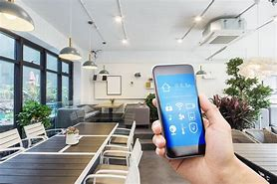
Home Automation
Home Automation is a system that allows users to control various appliances of varying kinds and also makes controlling of home appliances easier and saves energy.
On the other hand, it provides increased comfort especially when everyone is busy with their work. Home automation installed in houses does not only increase comfort but also allows centralized control of heating, ventilation, air-condition, and lighting.
Some of the most common applications of home automation are as follows-
Heating, ventilation, and air conditioning.
Lighting control system.
Occupancy-aware control system.
Leak detection.
Smoke sensors.

Slide 7

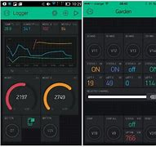
Blynk Platform
Blynk is an IoT-platform that consists of a Blynk server, custom projects within an iOS/Android mobile app and custom hardware IoT-nodes using a Blynk library.
The mobile app communicates with the hardware via the Blynk server and you can use the mobile interface for displaying sensor data from the hardware nodes or control actuators on the nodes.
Blynk IoT platform offers a full suite of software allowing to prototype, deploy, and remotely manage connected electronic devices at any scale.

Slide 8
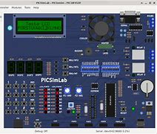
PICSimLab Simulator
PICSimLab is a real-time emulator for PIC and Arduino.
As the purpose of PICSimLab is to emulate real hardware it does not have any source code editing support.
For code editing and debugging the same tools used for a real board should be used with PICSimLab, such as MPLABX, VSCode with PlatformIO.
Features
Realtime emulation
Arduino support

Slide 9
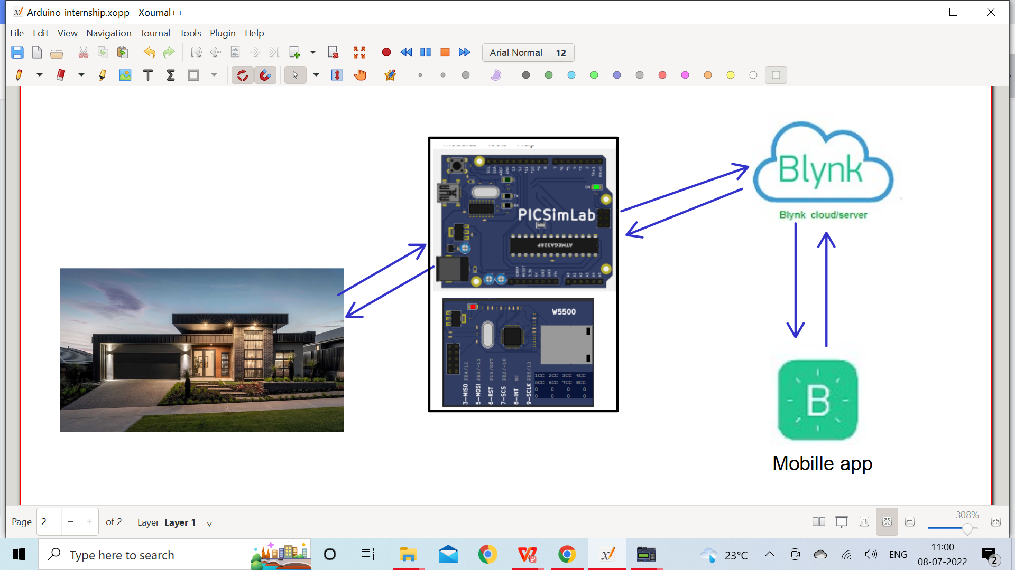
Mapping

Slide 10
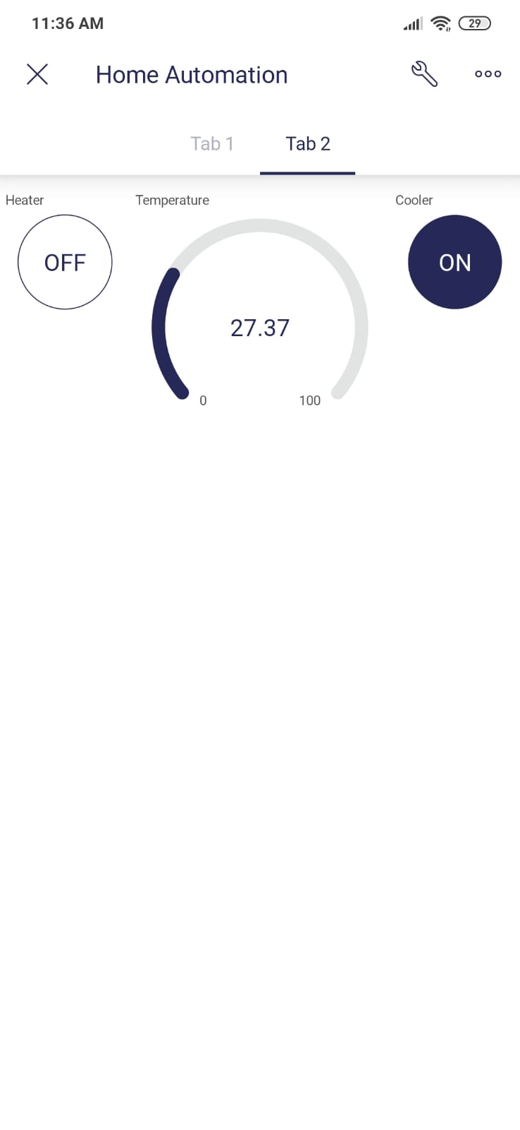
Blynk IOT App
Button widgets to control the heater, cooler and gauge widget to display the temperature.

Slide 11
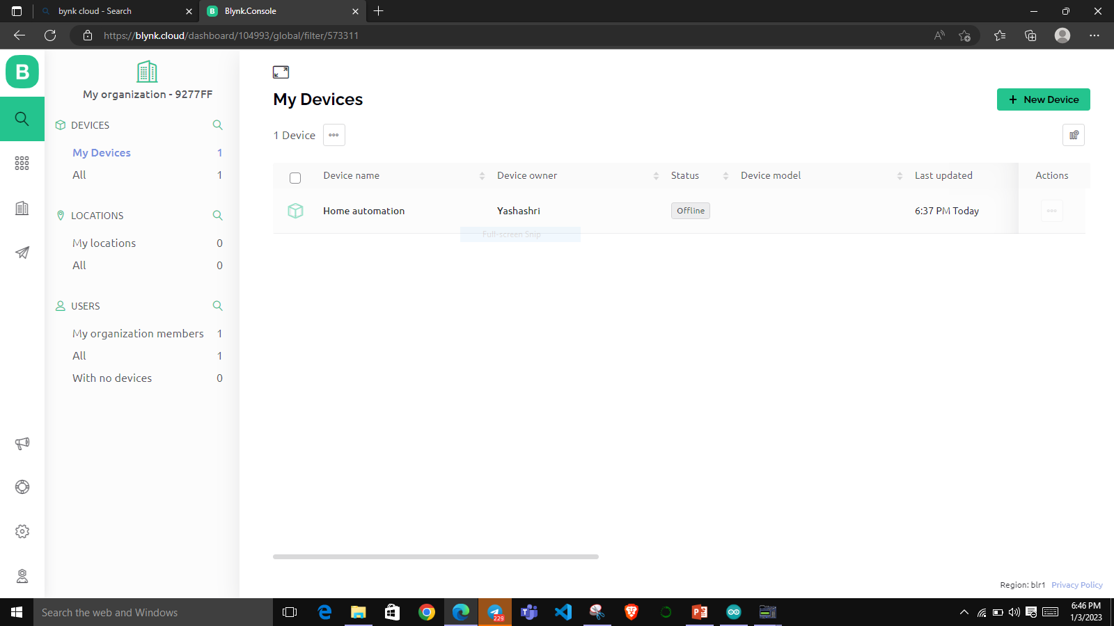
Blynk Dashboard

Slide 12
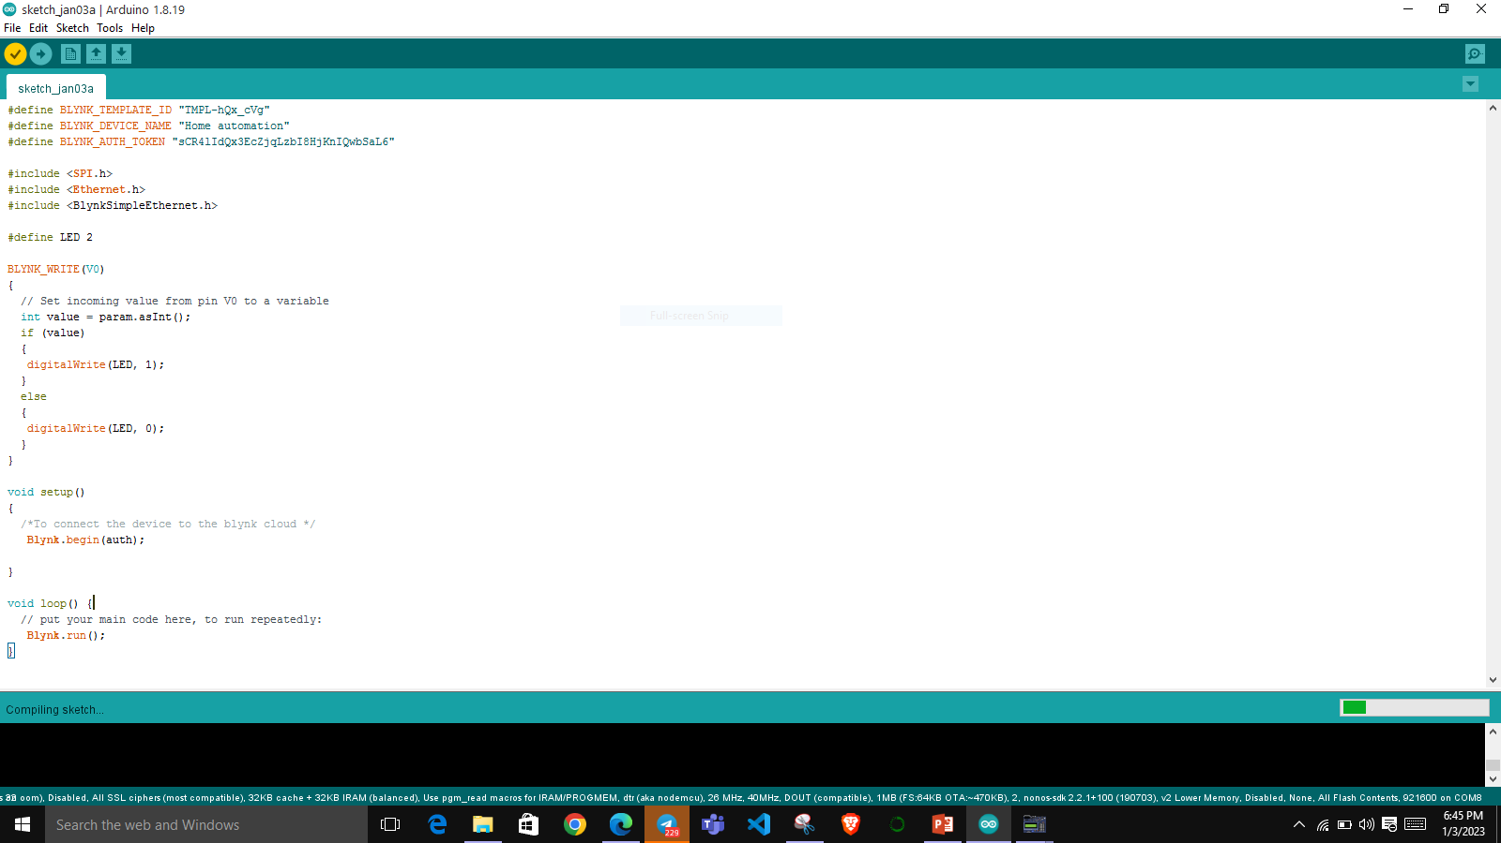
Arduino Code

Slide 13
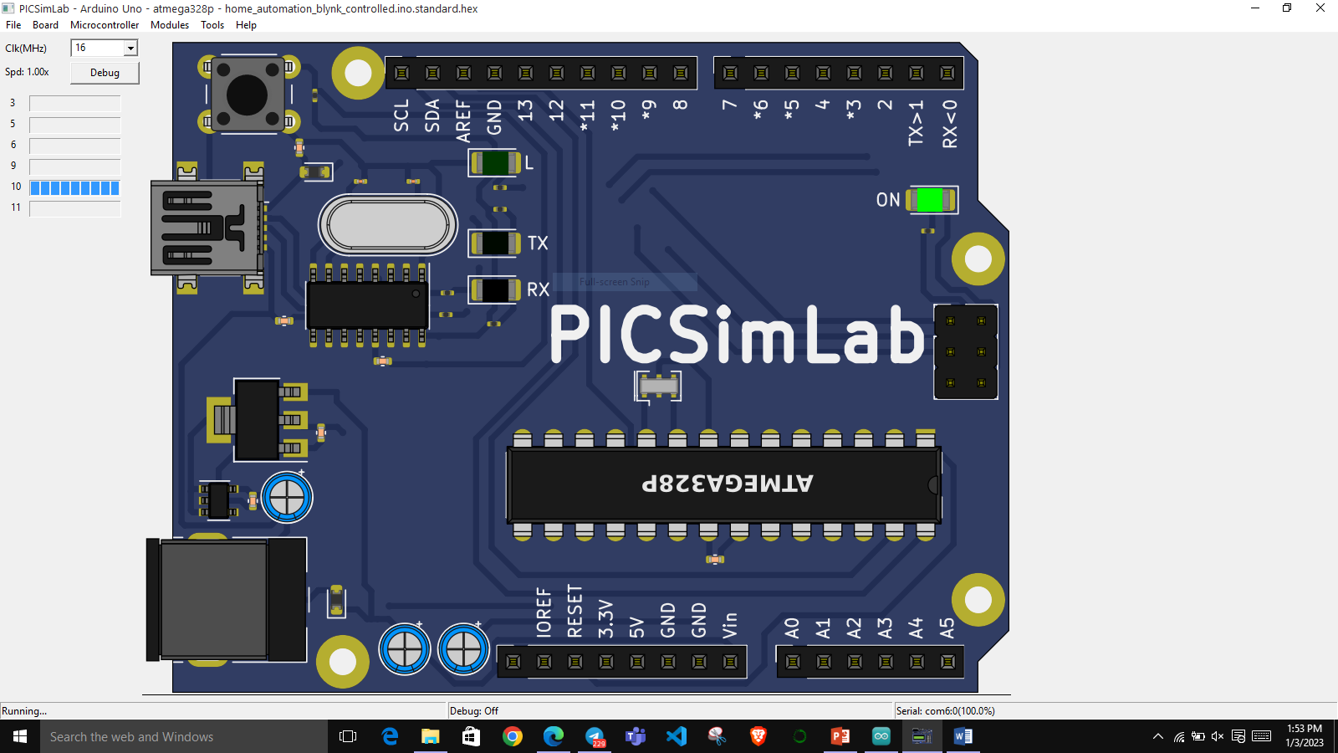
Simulation

Slide 14
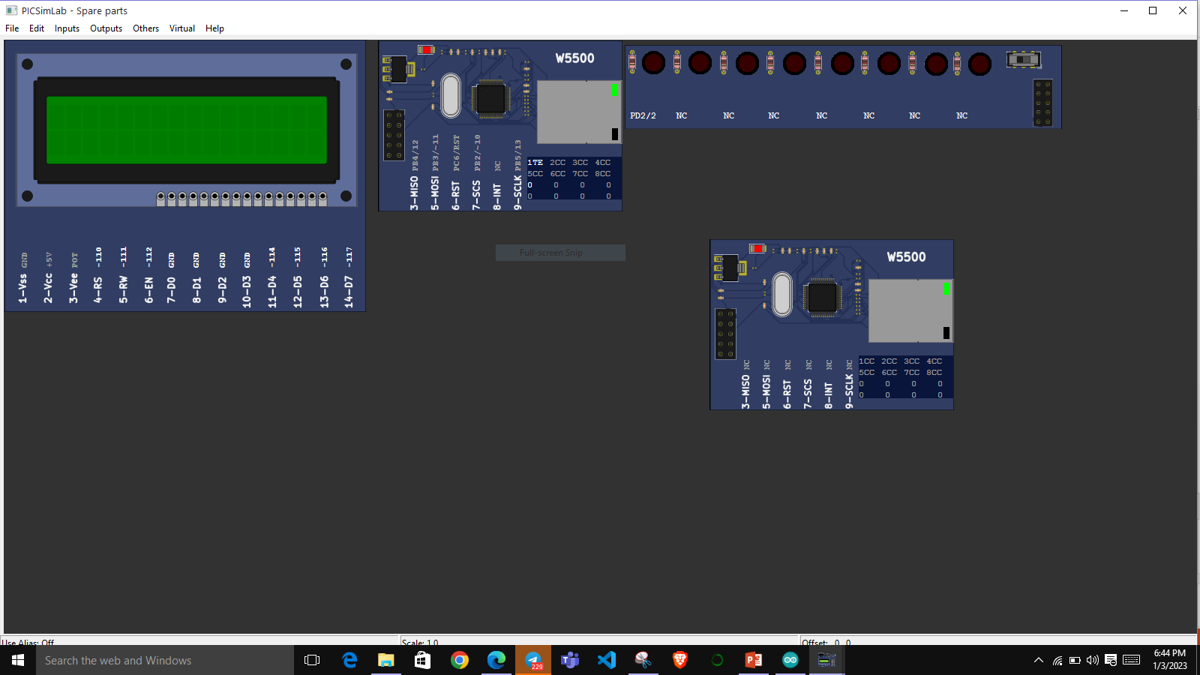

If Switch is ON If Switch is OFF

Slide 15
Conclusion
Using BLYNK IoT application and Picsimlab simulator, simulated home automation, where LED, temperature system, Serial tank resembles Light, Heater, Cooler and Water tank in real time.
CLCD acts like a dash board used for displaying the events, Widgets from Blynk IoT app like button widgets are used to control heater, cooler and inlet valve, outlet valve.
Gauge widgets to display the temperature and volume of the water

Slide 16
Thank You

